Slide 1
Kristen Swanson The Theory of Caring
Patricia Marchessault
James Madison University
Professional Role Transition
-Stasuk J.(2012)

Slide 2
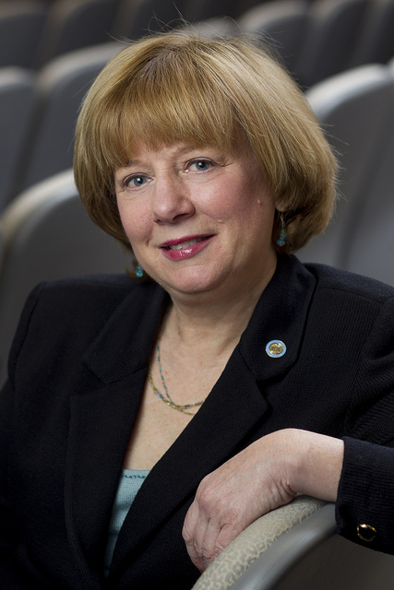
Kristen Swanson, RN, PhD, FAAN
Dean of School of Nursing University of North Carolina
Robert Wood Johnson Foundation
American Academy of Nursing
Department of Family and Child Nursing
Education
Bachelor Degree from University of Rhode Island
Master Degree from University of Pennsylvania
PHD from University of Colorado
-Virginia Medical Center, 2016
Notes:
Kristen M. Swanson is the Dean of the School of Nursing at the University of North Carolina at Chapel Hill, , and Associate Chief Nursing Officer for Academic Affairs at UNC Hospitals.
She is an alumnus of the Robert Wood Johnson Foundation Nurse Executive Fellows program and a member of the American Academy of Nursing. she held the University of Washington Medical Center Term Professorship in Nursing Leadership. She also served as Chairperson of the Department of Family and Child Nursing at the University of Washington School of Nursing where she was a faculty member for over 20 years
.
Since coming to the School of Nursing, Dean Swanson has focused on intensifying the relationship between nursing education, research and practice.
Dean Swanson earned her bachelor's degree in nursing in 1975 from the University of Rhode Island,
her masters in adult health and illness nursing in 1978 from the University of Pennsylvania,
and her PhD in 1979 in psycho-social nursing from the University of Colorado.
She completed her postdoctoral work at the University of Washington
. In addition to holding a faculty position at the University of Washington, she taught at Trenton State College, the University of Pennsylvania School of Nursing, and the University of Colorado School of Nursing.
In 2002, she was awarded the University of Rhode Island College of Nursing Distinguished Alumni Award. She is also on the editorial board or serves as a reviewer for the Jour-nal of Nursing Scholarship, Nursing Outlook, Re-search in Nursing and Health, and the Interna-tional Journal of Human Caring.
Kristen M. Swanson, RN, PhD, FAAN Bio-sketch

Slide 3
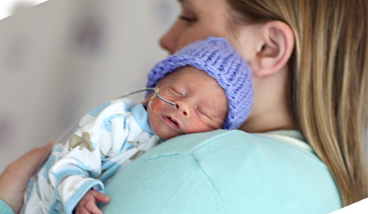
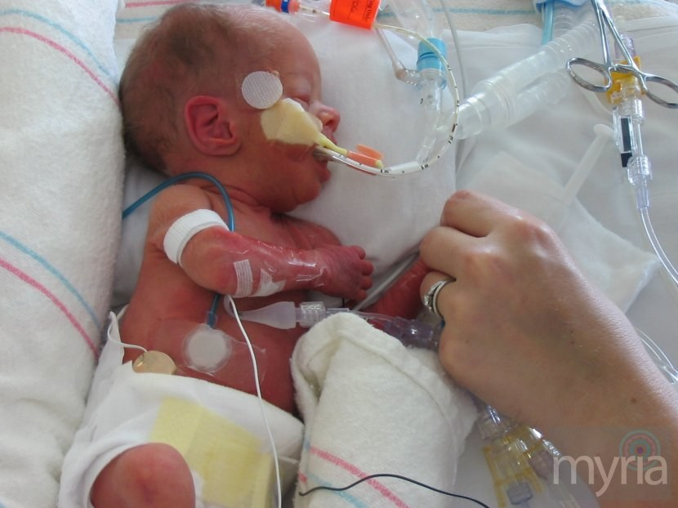
Who and What Influenced her
Women who experienced miscarriage
Care givers of infants in the NICU
Interviewed socially at risk mothers
Wojnar, Swanson & Adolfsen, 2011
Notes:
She is known for her research on pregnancy loss and for development of the Swanson Theory of Caring – a theory that is used internationally to guide research, education, and practice
She began this work with her dissertation, “The Unborn One: A Profile of The Human Experience of Miscarriage,” and has continued studying this area both as an investigator and as a consultant to other investigators.
It is during this time that she developed the Swanson Theory of Caring.
She developed her theory of caring from 3 studies in different perinatal situations
In the first study women who rectly miscarried wwere interviewed twice concerig the following question: What are the caring behaviors of others that are identified as helpful by women who have miscarried. She had an intense interest in what it was like to miscarry. As a doctoral studnt she was approached by Dr. Jean Watson, who founded the Center for Human Caring n Colorado to work with her in exploring what caring meant from the perception of the women who miscarried
In the second study, data was collected through observation of care provision and interviews of care providers, parents and professional caregivers. This analysis was guided by the question – What is it like to be a provider of care on the Newborn Intensive Care Unit. She conducted this study with Dr. Kathryn Barnard at the University of Washnington. Swansons second child was not well at birth and was in the newborn intensive care unit. She became interested in the care of vulnerable infants and wanted to know what it was like to provide care for a vulnerable baby by interviewing mothers, fathers physcianas and nurses.
The third study described eight mothers experiences of participating in an intervention where the research question was – How do receipents of a long term intensive nursing intervention recall and describe the nurse-patient relationship four years after the intervention. She had the opportunity to speak to masters prepared public health nurses who had taken part in a study conducted by Dr.Kathryn Barnard and her colleagues. The purpose of Dr. Barnard’s project was to help the women to take care of themselves in order that they take car of their infants.

Slide 4
Caring
Caring is a nurturing way of relating to a valued other person, towards whom one feels a personal sense of committent and responsibility
(Andershed,2009)
Notes:
From those studes, she formulated the the overall definition of caring.

Slide 5
Metaparadigm
Nursing
Health
Environment
Person
-Chinn & Kramer, 2008
Notes:
The framework to her theory of caring includes person, environment, health and nurse. She described the assumption of caring is related to the person , the environment, health and well being and caring actions.
Watson originally proposed that how nurses view persons sets the stage for who the client of nursing is and what constitutes the practices, environments and goals of nursing care.
The Conceptual framework involves these four concepts. Swanson identifies that persons are unique beings with thoughts, feelings and behaviors. This includes individuals, families, groups or societies as well as the well being of each nurse.
The environment is situational. This includes the cultural, economic, social, biophysical, psychological and spiritual realms . It is benefical to consider the demands, constraints and resources of an individual and the surrounding environment.
The health or well being of an individual includes health as well as the absence of illness, the ability to perform one s roles, the capacity to adapt, and the pursuit of well being . Well being is living in such a place that one feels integrated and engaged with living and dying Health, illness, deviance and pathology are influenced by societal values, political ideations, cultural norms and economic conditions. Health is a dynamic process that changes with time and varies with life circumstances.
Persons are molded by the environment in which they exist. Cultural and social aspects are interacting forces that shape an individual
The nurses role in this interaction primarily is one of facilitating , enabling the will and behavior of the person receiving care Nursing processes and actions rests on the nurses initiative, knowledge and approaches with interpersonal interactions as a focus

Slide 6
Five Key Concepts to The Theory
Knowing
Being With
Doing for
Enabling
Maintaining belief
-Swanson, 1993
Notes:
According to Swanson, she began to think about caring based therapeutics and answers to questions about how nursing could and should be. This middle range theory of caring was developed with five caring processes: Knowing, Being with, doing for, enabling and Maintaining a belief. She describes her theory with the clients well being as an intended outcome and how the five caring processes relate to each other Maintaining a belief in a person is the basis of nursing care. These five theories relate to each other. She stated that caring begins with a fundamental belief in persons and their capacity to make it through events and transitions and face a future with meaning.

Slide 7
- Sustaining faith
- Believing In
- Maintaining a hope-filled attitude
- Offering optimism
Maintaining Belief
-Andershed, 2009
Notes:
Maintaining a belief in persons is at the base of caring, it is there that nurses define what matters and where to address their care. Clients are able to understand that there is a personal meaning to be found in whatever health condition or developmetal challenge a person is facing. It is sustain faith in the capacity of others to get through events or transitions and face a future with meaning that initiates and sustains nurse caring.

Slide 8
-Striving to understand an event, its meaning in the life of the others
-Avoiding assumptions
-Centering on the one cared for
-Assessing thoroughly
-Seeking Cues
-Engaging the self or both
Maintaining Belief
Knowing
-Andershed, 2009

Slide 9
Being emotionally present to the other
Being there
Conveying ability
Sharing feelings
Not burdening
Being With
Maintaining Belief
Knowing
-Andershed, 2009
Notes:
Being with is the caring category that conveys to clients that no only their experience but they themselves matter to the nurse It is another persons experience of the situation that is the starting point of one understanding. . Being with is a step beyond knowing and involves becoming emotionally open to the other person’. Emotional presence is a way of sharing in the meanings, feelings and actual experiences of the client It assures clients that their reality is appreciated and that the nurse is ready and willing to be there for them. This does not only include physical presence but conveys a message of availability and ability to endure and experience with another person . To share feelings like happiness or sadness, without burdening the one cared for are important in letting them know that they are not alone.

Slide 10
Doing for others as they would do for themselves if possible
Comforting
Anticipating
Performing skillfully
Protecting
Preserving dignity
Maintaining Belief
Being
With
Doing For
Knowing
-Andershed, 2009
Notes:
Doing for includes actions th;at are helpful, protective or comforting. Actions that a person would normally doe for themselves if it were possible. This includes comforting another person anticipating their needs performing competently andskillfully and pretecting the other person while preserving their dignicty. This does not just involve physical action. It involves the interpersonal therapeutic communication skills as well as setup up opportunities, programs or systems that provide a safe place where people can bring about their own healing

Slide 11
-Facilitating the others passage through life transitions and unfamiliar events
-Informing
-Explaining and supporting
-Allowing, focusing, generating alternatives
- Validating and giving feedback
Maintaining Belief
Knowing
Being
With
Enabling
Doing For
-Andershed, 2009
Notes:
Enabling is defined as facilitating theothers passage through life transtions andunfamiliary events. This includes coaching, informing, and explaining to the another person, supporting them and allowing them to have their own experience. In involves assisting the other person to focus in on important issues. Helping themto find alternatives and guiding them to think things thgouh. As nurses we can offer feedback and validate another persons reality. The goal of enabling is to assure the others long term well being. The purpose is to facilitate another persons capacity to grow heal and practice self care

Slide 12
Client
Well-Being
Maintaining Belief
Knowing
Being
With
Doing For
Enabling
-Swanson,(1993)

Slide 13
Relevance to practice
Used in all settings and situations in nursing
Improved quality of outcomes
Enhanced competence of nurses
Nurse Satisfaction
Research
Education
-Chinn & Kramer(2008)
Notes:
Although the basis of Swansons theory focused on perinatal circumstances, this theory can be applied in any setting. Caring theory assumes that nurses demonstrating they care about patients is as important to a patient well being as caring for them through clinical activities SUCH as preventing infection and administering medications. As people are guided through discussions of their experiences and feel understood, informed, provided for,and believed in they would be better prepared to integrate difficulties into their lives . It is important to increase the nurses awareness of using this theorY concerning the caring nursing process. It is also important that researchers and nurse scholars build upon the strengths of earlier studies and theories to bridge the gaps, DEVELOP GUIDELINES AND GENERATE FURTHER STUDIES IN ORDER TO MOVE TOWARDSa greater understanding of caring and nursing . IN EDUCATION, STUDENT ARE TAUGHT TO INTEGRATE CARING INTO THEIR PRACTICE

Slide 14
References
Andershed, B., & Olsson, K. (2009). Review of research related to Kristen Swanson's middle-range theory of caring. Scandinavian Journal Of Caring Sciences,23(3), 598-610. doi: 10.111/j.1471-6712.2008.00647.x
Chin, P.L. & Kramer, M.K. (2008) Integrated theory and knowledge development in nursing (7th ed.) St. Louis, MO: Mosby
Swanson, K.M.(1993)Nursing as informed caring for the well-being of others. Journal of Nursing Scholarship 25(4) pp 352-357
Stasuk, J.( 2012,02,26) Theory of Caring (Video file) Retrieved from https://www.youtube.com/watch?v=GtWr3kiMAY8
Virginia Medical Center(2016) Virginia Mason launches new model of nursing care. Retrieved from https://www.virginiamason.org/body.cfm?id=158&action=detail&ref=3774
Wojnar, D.M., Swanson, K.M., Adolfsson, A. (2011) Confronting the inevitable: A conceptual model of miscarriage for use in clinical practice and research. Death Studies 35 pp 536-558 doi: 10.1080/07481187.2010.536886

